Slide 1
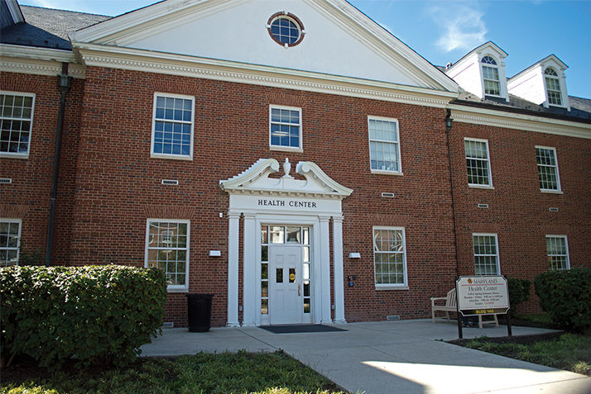
UNIVERSITY HEALTH CENTRE
DATABASE MANAGEMENT SYSTEMS
Submitted By: Roma Kaul
Sneha Saxena
Sarthak Potnis

Slide 2
AGENDA
University Health Centre
Mission statement and objectives
Conceptual database design
Logical database design
Physical database design
Use case analysis
Future scope

Slide 3
University Health Centre
Medical Home provides patient-centered, provider-directed, comprehensive care, built upon a continuous relationship between a patient and a specific health care team.

Slide 4
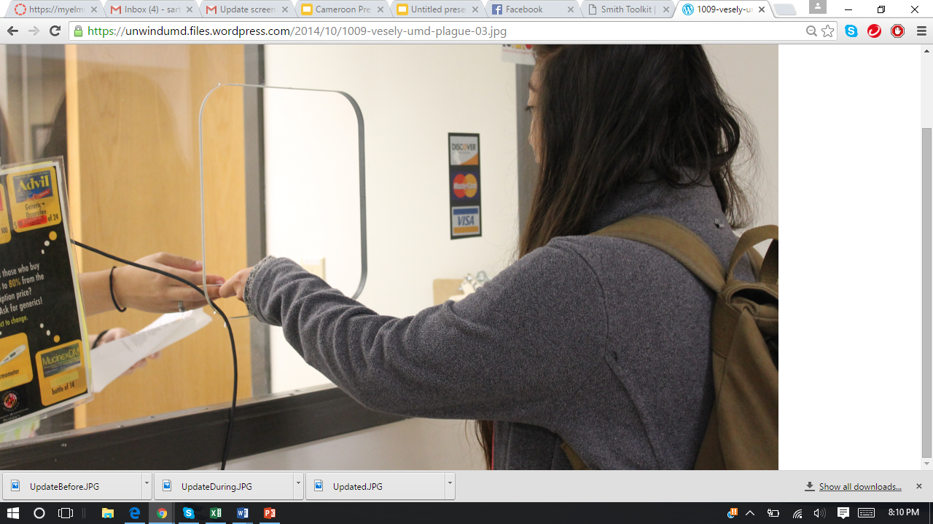
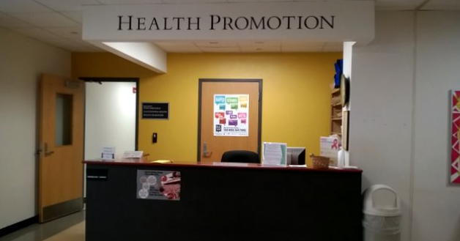
A GLANCE AT HEALTH CENTRE
Billing Counter
Help Desk

Slide 5
CURRENT STATUS
Maintains records of : Students
Doctor
Medicene
Treatments
Stores Treatment details of Patients for billing purposes.

Slide 6
MISSION STATEMENT
Build a Digital database of UMD Health Center to enhance existing services while adding new features to increase the efficiency of record keeping and functionality of the Health Center.

Slide 7
MISSION OBJECTIVES
To build a generic database for the Health Center
Maintain information about Doctors serving at the Health Center and about all Patients (Students)
Maintain records of Medicines prescribed to every patient
Maintain details of the Treatment provided to every Patient in tandem with the Billing and Insurance information.

Slide 8
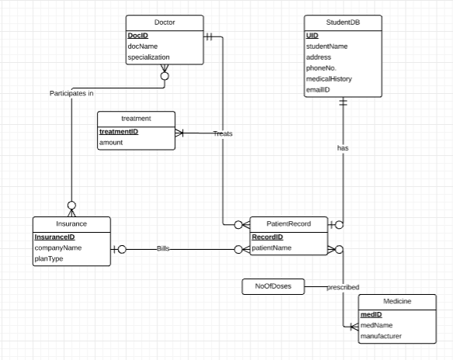
CONCEPTUAL DATABASE DESIGN
Summary Table
Entities : 06
Relations
One to one:1
One to many relation: 01
Many to many relation: 02
Ternary relation: 01

Slide 9
LOGICAL DATABASE DESIGN (RELATIONAL SCHEMA)
StudentDB (uID, studentName, address, phoneNo, emailId, medicalHistory, recordID)
Doctor (docID, docName, specialization)
Insurance (insuranceID, companyName, planType)
Medicine (medID, medName, manufacturer)
PatientRecord (recordID, patientName, patientBill, docID)
Treatment (treatmentID, amount)
Participates In: (insuranceID, docID)
Treats: (docID, recordID, treatmentID)
Prescribed: (recordID, medID, NoOfDoses)

Slide 10
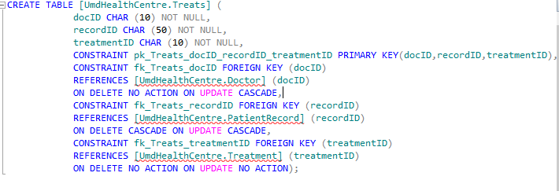
PHYSICAL DATABASE DESIGN
Creation of Table “Treats” where docID, recordID & treatmentID are foreign keys

Slide 11
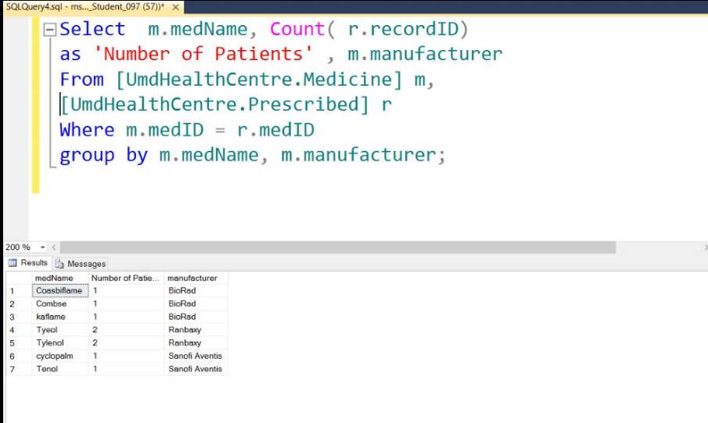
USE CASE ANALYSIS
Business Transaction: To find the number of Patients using a particular Medicine and display the corresponding Medicine and Manufacturer names.

Slide 12
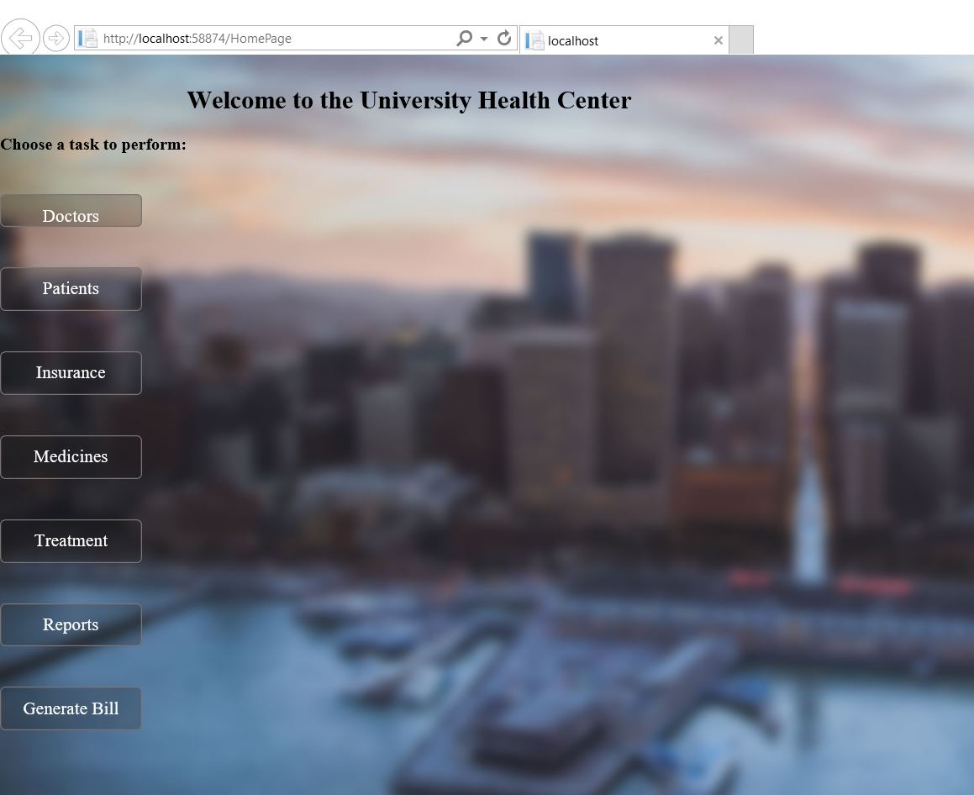
PRACTICAL IMPLEMENTATION ON FRONTEND
FRONT END DISPLAY
Framework used: .NET 4.0

Slide 13
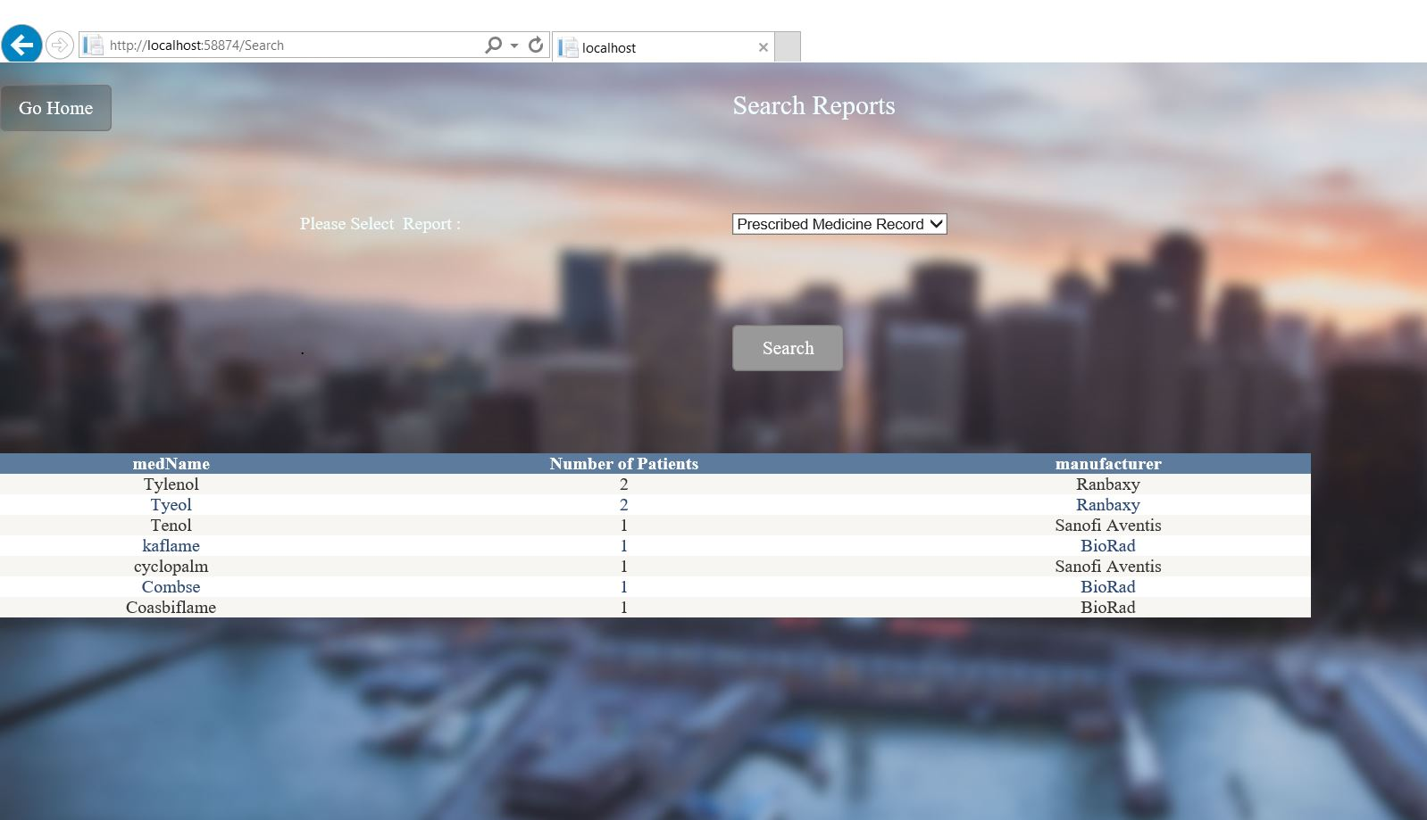
OUTPUT OF USE CASE ANALYSIS ON FRONTEND
The report for Prescribed Medicine Record displays the number of patients using a particular medicine, the corresponding medicine and manufacturer names.

Slide 14
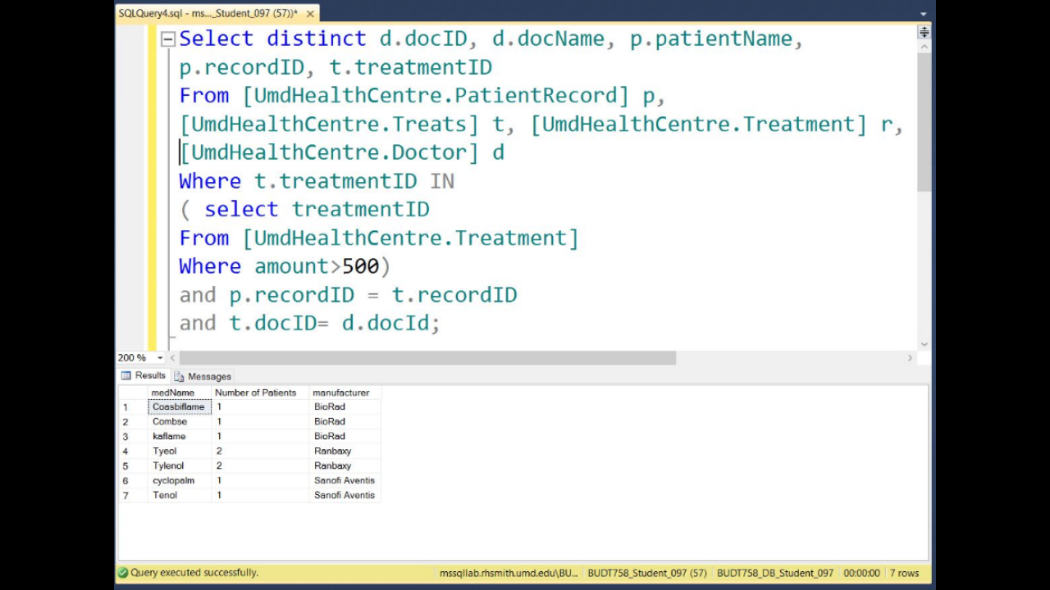
BUSINESS TRANSACTION WITH SELECT STATEMENT
Selecting docID, docName, recordID and treatmentID where total amount > 500

Slide 15
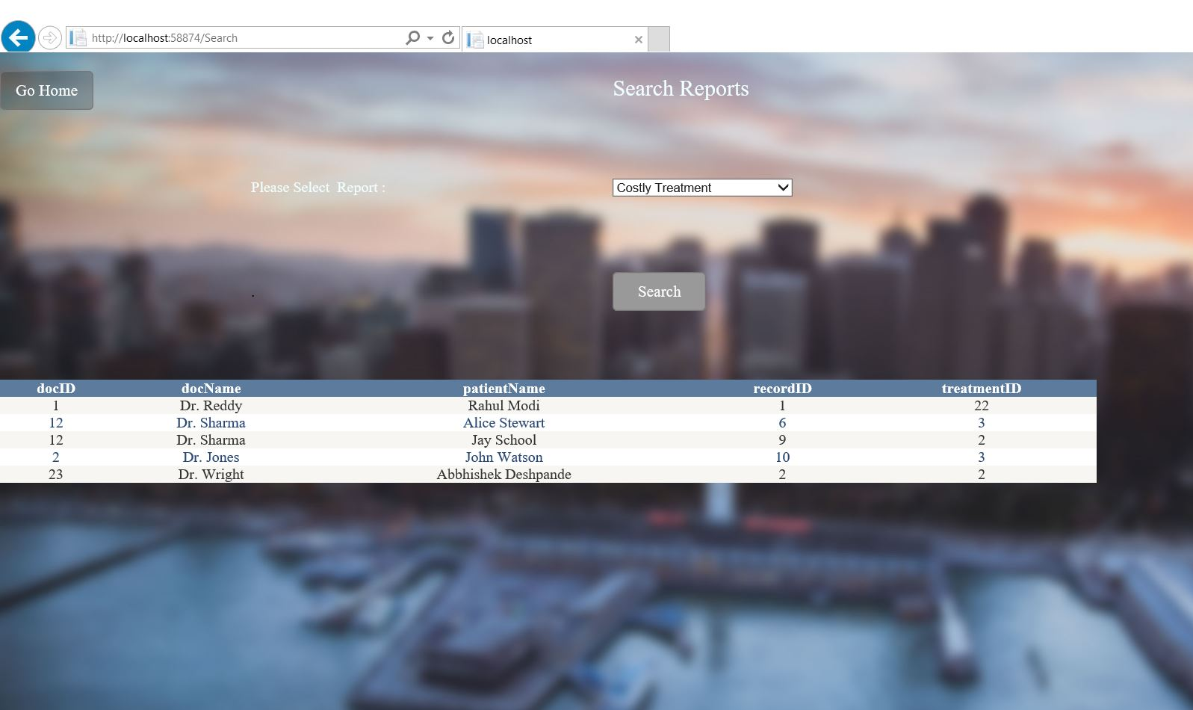
FRONTEND IMPLEMENTATION
The report for Costly Treatment displays Doctor ID, Doctor name, Patient name, Record ID and Treatment ID associated with costliest treatment available.

Slide 16
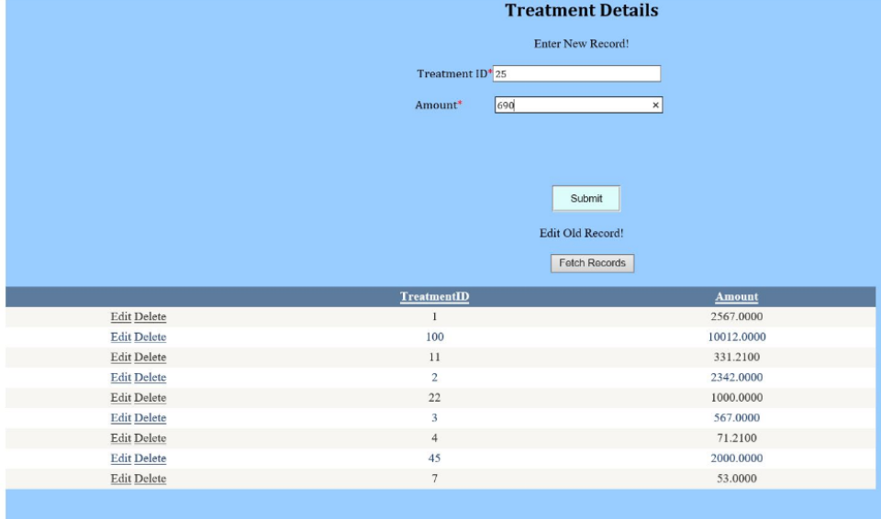
FRONTEND IMPLEMENTATION - INSERT QUERY

Slide 17
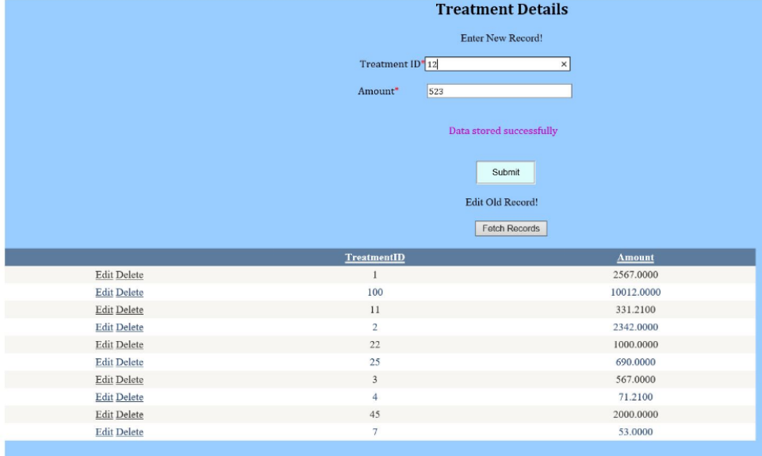
OUTPUT OF INSERT QUERY ON FRONTEND

Slide 18
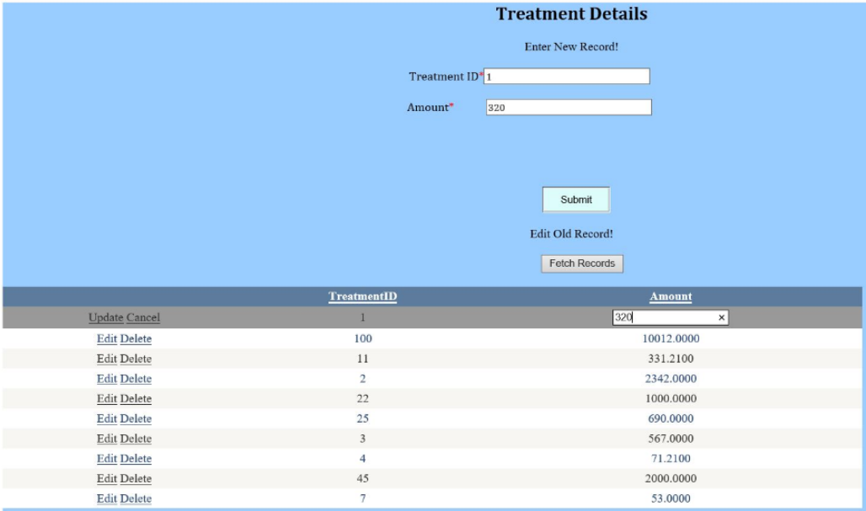
FRONTEND IMPLEMENTATION - UPDATE QUERY

Slide 19
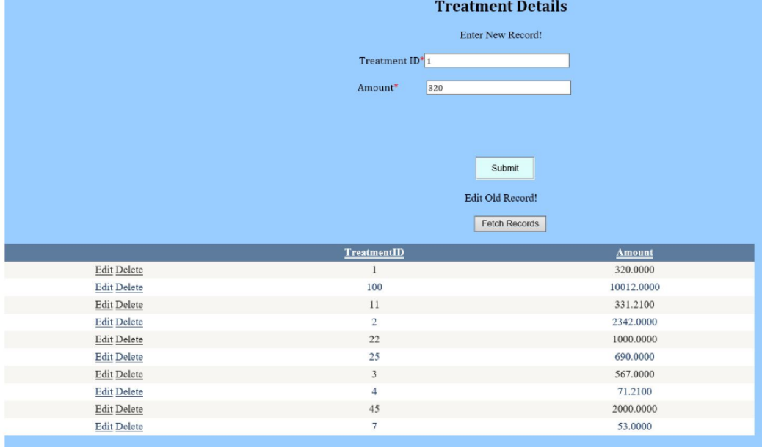
OUTPUT OF UPDATE QUERY ON FRONTEND

Slide 20
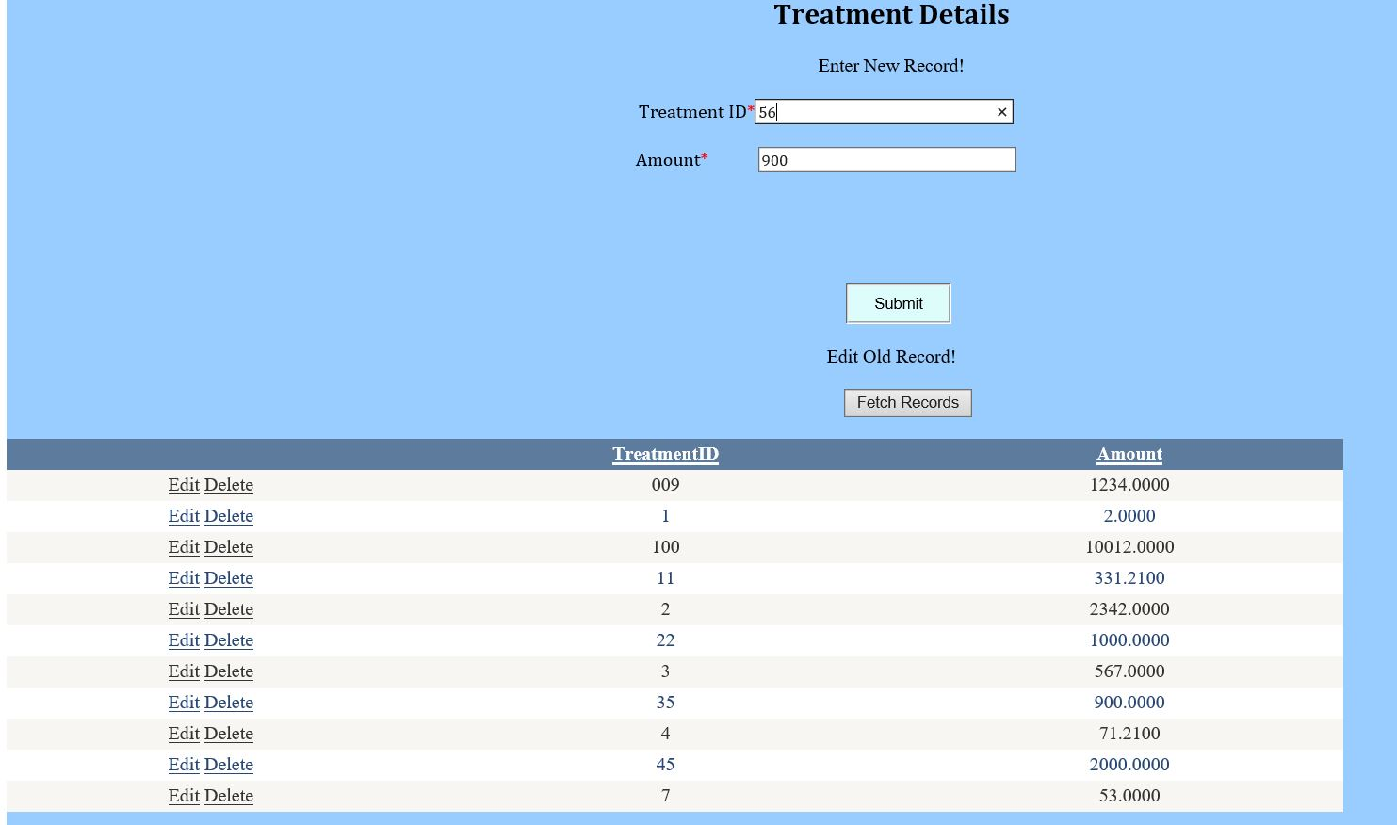
FRONTEND IMPLEMENTATION - DELETE QUERY

Slide 21
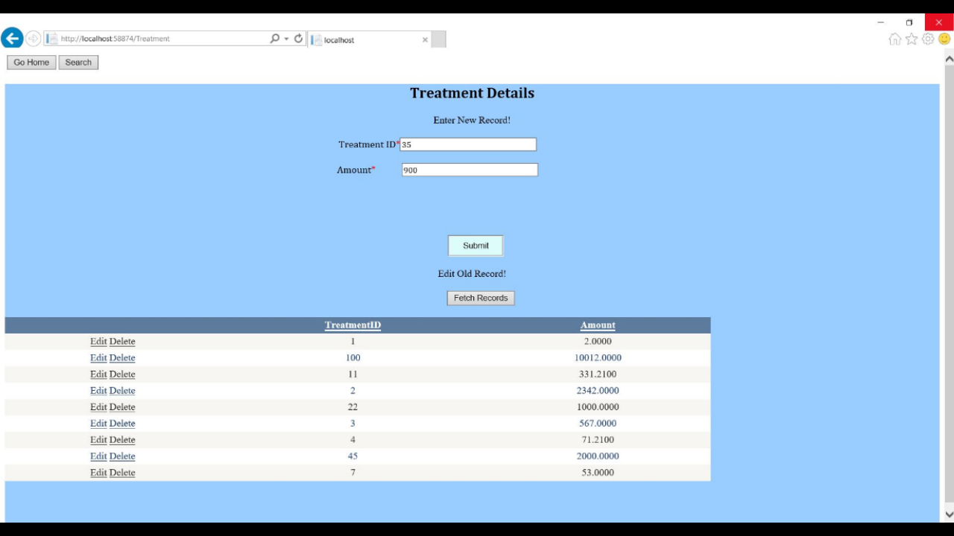
OUTPUT OF DELETE QUERY ON FRONTEND

Slide 22
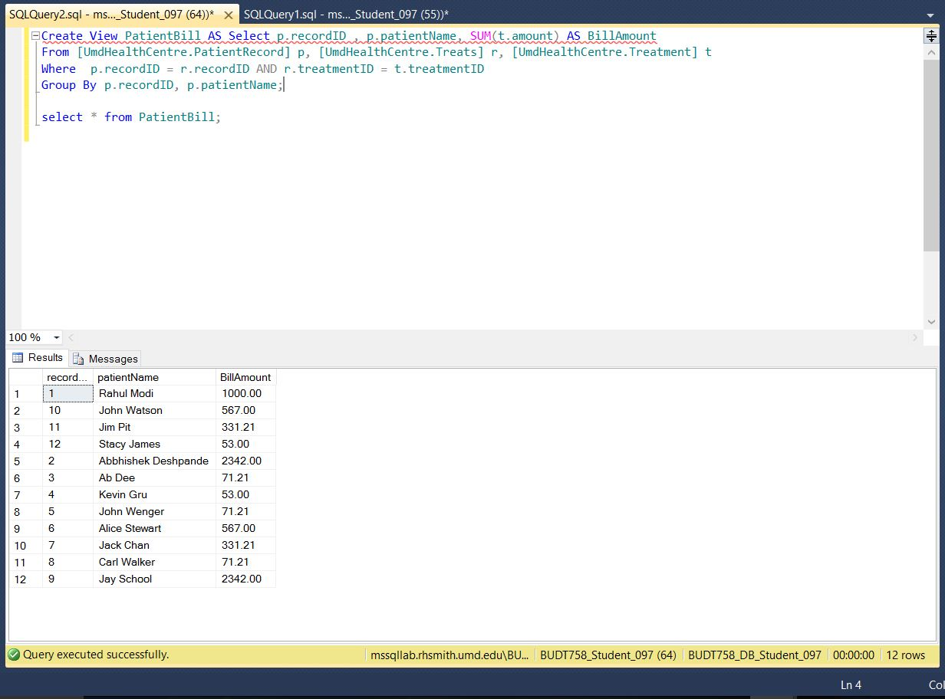
BILL GENERATION USING VIEW

Slide 23
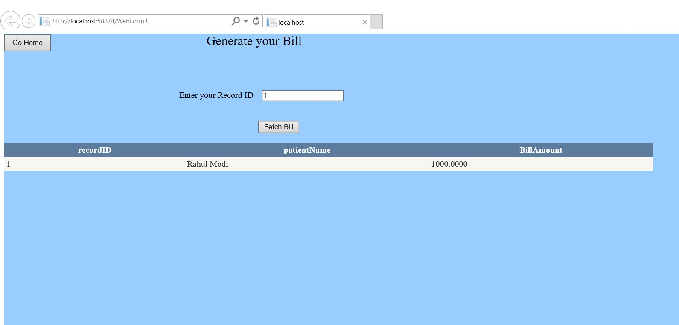
OUTPUT OF BILL GENERATION USING VIEW ON FRONTEND

Slide 24
FUTURE SCOPE
Ability to set, track, cancel Patient appointments with the Health Center and have the appointments added to the Student(Patient) calendars
The system can track Medicines available, Patient records and visiting Doctors associated with the respective Treatments and Patients

Slide 25
THANK YOU

